Slide 1

DATABASE SYSTEMS (EIE36E): ALIASES, DDL - VIEW
Doc. Ing. Václav Vostrovský Ph.D.
Ing. Petr Hanzlík

Slide 2

Outline > Aliases and VIEWS
SQL: Alias
Database VIEW
CREATE VIEW
DROP VIEW

Slide 3
SQL DML: ALIAS
SQL alias AS can be used to give a database table, or a column in a table, a temporary name.
SQL column ALIAS syntax:
SELECT column_name(s) [AS “alias name“]
FROM <table_name> WHERE <conditions>
;

Slide 4
SQL DML: ALIAS
SQL table ALIAS syntax:
SELECT t.column_name(s) [AS “alias name“]
FROM <table_name> t WHERE <conditions>
;

Slide 5
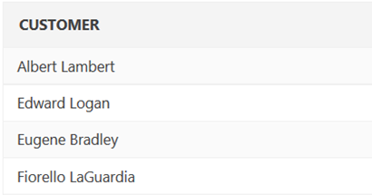
SQL DML: ALIAS example
Name tables and columns for readability and query convenience
SELECT c.Cust_first_name||' '||c.Cust_last_name AS Customer
FROM Demo_customers c;
;

Slide 6
SQL DDL: CREATE VIEW
SQL alias AS can be used to give a database table, or a column in a table, a temporary name.
SQL column ALIAS:
SELECT column_name(s) [AS “alias name“]
FROM <table_name> WHERE <conditions>
;

Slide 7
SQL DDL : VIEW
VIEW is a virtual table based on the result-set of an SQL statement. It contains rows and columns, just like a real table.
CREATE AND MANIPULATE A TABLE:
CREATE VIEW
DROP VIEW

Slide 8
SQL DDL: CREATE VIEW
CREATE VIEW create a database view based on specified conditions
SQL CREATE VIEW syntax:
CREATE VIEW <view_name> AS SELECT column_name(s)
FROM <table_name> WHERE <conditions>
;

Slide 9
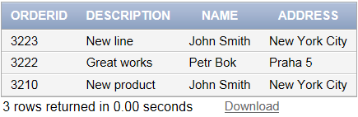
SQL DDL: CREATE VIEW example
Create a database view, that selects all the orders with matching customers.
CREATE VIEW erp AS SELECT order.orderid,order.description,
customer.name,customer.address
FROM order INNER JOIN customer
ON customer.customerid = order.customerid
;

Slide 10
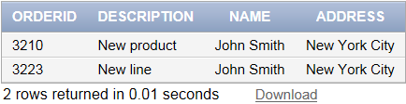
SQL DDL: CREATE VIEW example
The view is now available for queries as any normal table
SELECT * FROM erp
WHERE name LIKE 'John%' ORDER BY orderid
;

Slide 11
SQL DDL: DROP VIEW
DROP VIEW removes defined database view
SQL DROP VIEW syntax:
DROP VIEW <view_name>;

Slide 12


SQL DDL: DROP VIEW confirmation
Remove defined view
ORA-00942: table or view does not exist
DROP VIEW erp;
SELECT * FROM erp;

